Slide 1
ASUG maturity model

Slide 2
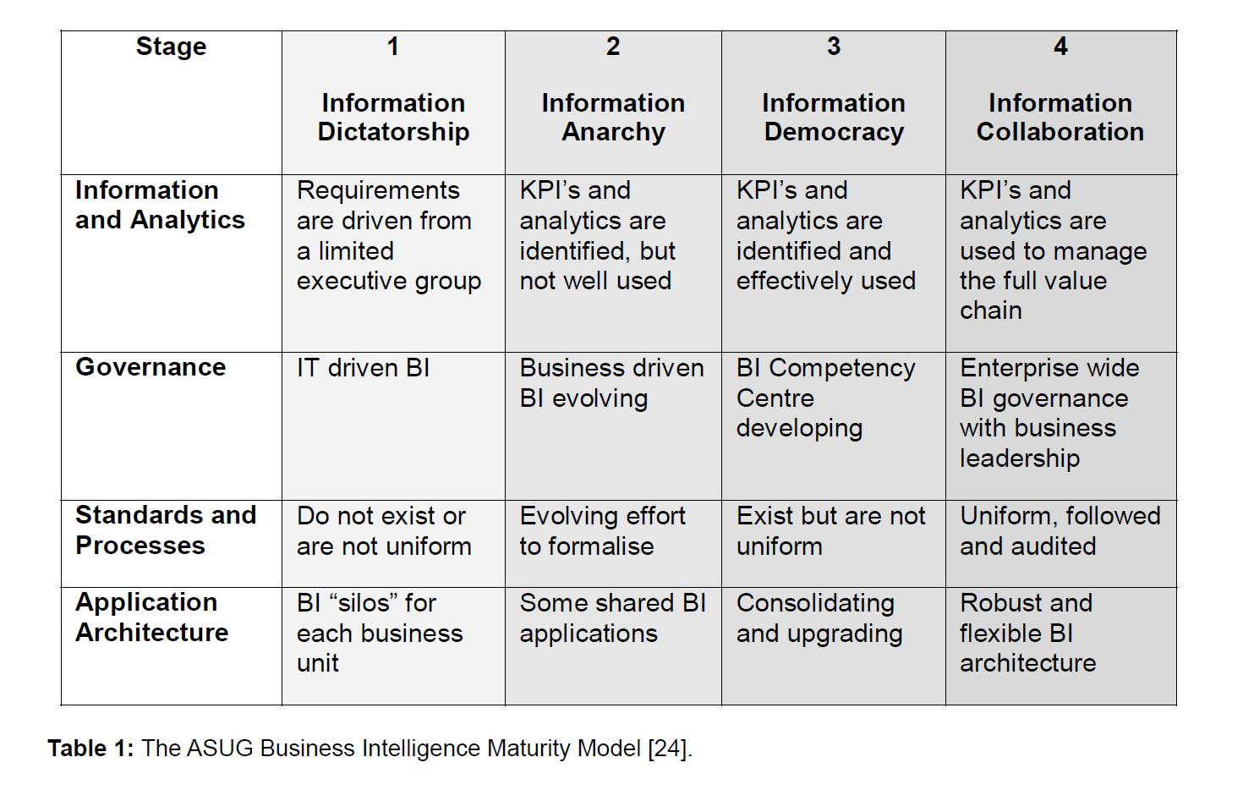

Slide 3
SAP User Group Overview
ASUG (Americas' SAP Users' Group) is a global SAP user group with more than 85,000 members from 4,000 companies.
SAP is the market share leader in both ERP systems and Business Intelligence.

Slide 4
ASUG's Benchmarking Studies
ASUG developed a series of benchmarking studies to assist its members in better understanding the implementation and usage of ERP systems and associated solutions such as Business Intelligence.
In 2007, ASUG, in conjunction with SAP, developed a Business Intelligence benchmarking initiative with over 100 companies participating.

Slide 5
Key Questions of the BI Benchmarking Study
The study aimed to answer key questions such as:
• How do companies leverage Business Intelligence to drive business performance?
• For which business process is Business Intelligence most critical?
• What are the key performance indicators of an effective BI environment?
• How much do top-performing companies invest in Business Intelligence?
• What best practices can companies adopt to drive effectiveness and efficiency of their BI environment?

Slide 6
Data Collection and Comparison
Key metrics were designed to capture information to answer these questions.
The website was developed to capture enough information from different companies' BI experiences to enable relevant comparisons.
These details were compared to those of other companies and industry standards, allowing for the creation of a range of BI benchmarks.

Slide 7
ASUG Business Intelligence Maturity Model
Part of the benchmarking process involved mapping companies to a maturity model.
The ASUG BI Maturity Model classifies BI maturity based on practices related to Application Architecture, Standards and Processes, Governance, and Information and Analytics.
Each of these practices includes several stages describing different aspects of BI maturity.

Slide 8
Investigation of BI Maturity Model Applicability
adopts a case study approach to investigate the BI operations of a recent BI Award of Excellence recipient, (alias CompPack).
The BI operations are then mapped to the ASUG BI Maturity Model to investigate its applicability.

Slide 9

CompPack's Business Intelligence Journey
A Case Study of BI Implementation and Maturity

Slide 10

Introduction to CompPack
CompPack is a global food packaging and processing company established in 1929. It employs 20,000 people, operates 50 factories, and has sales operations in 150 countries.
In 2008, CompPack produced 141 billion packages, resulting in total sales of €8,610 million.

Slide 11
SAP ERP and BI Implementation
CompPack implemented a SAP ERP system in 1994, followed by a data warehouse.
Despite challenges, a phased implementation approach was used to minimize risks.
The implementation faced delays and budget overruns, leading to performance issues in data accessibility.

Slide 12

Shift to Business Warehouse and BI Standardization
In 2006, CompPack halted the data warehouse project and initiated a new Business Intelligence project named 'Business Warehouse.’ T
The project aimed to standardize BI infrastructure across CompPack using SAP BW, improving data availability and performance.

Slide 13
Key Milestones and Improvements
The Business Warehouse project had two major milestones:
1. Replacing a legacy financial consolidation system with SAP BW.
2. Loading management accounting data into BW to report on key performance indicators (KPIs).
The availability of key data and improved reporting performance increased user support and acceptance of the BW system.

Slide 14
BI Competency Centre (BICC)
CompPack established a BI Competency Centre (BICC) to develop the overall strategic plan for BI.
The BICC consists of Business Information Management (BIM), Global Information Management (GIM), and Global Process Owners/Drivers (GPO/GPD), ensuring a focused and business-aligned approach to BI.

Slide 15
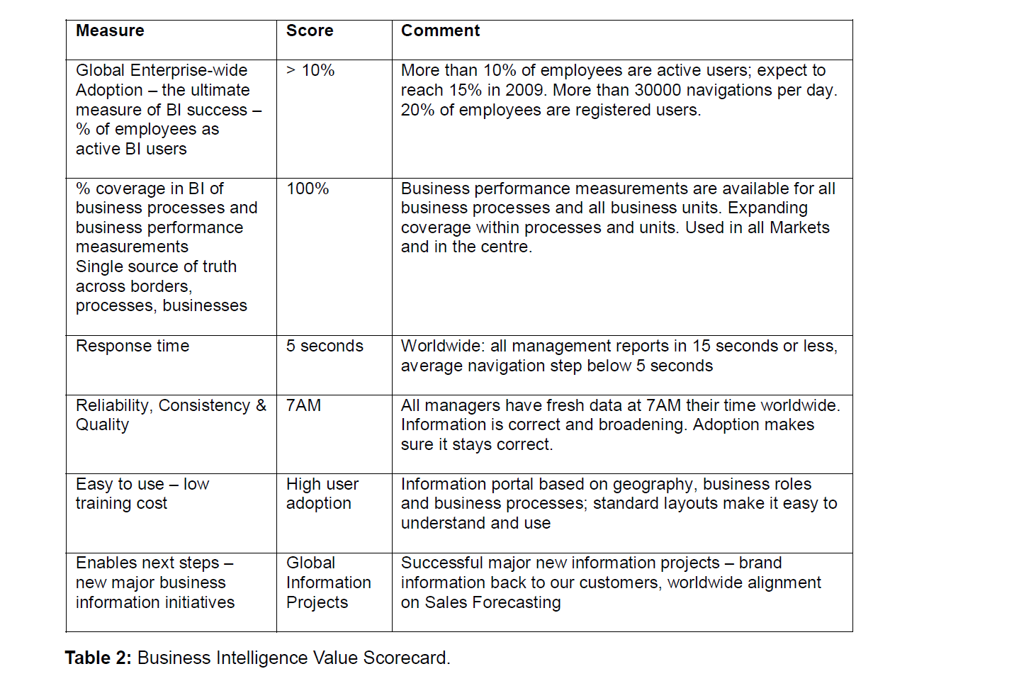

Slide 16
Business Intelligence Success
By June 2009, CompPack had 2,600 active BI users, representing 12.5% of employees.
The Business Intelligence Effectiveness Scorecard was developed to quantify BI's impact on business performance.
CompPack's approach to BI has led to significant improvements in core business processes, reducing time and costs.

Slide 17
BI Maturity Model Applicability
CompPack's BI implementation aligns with the highest level of the ASUG BI Maturity Model, Information Collaboration.
This maturity level is supported by CompPack's achievement of the Gartner BI Award of Excellence in 2009.

Slide 18
Conclusion
The ASUG BI Maturity Model effectively classifies BI usage and best practices. CompPack's case study exemplifies BI best practices and the importance of aligning BI with corporate performance management.

